Slide 1
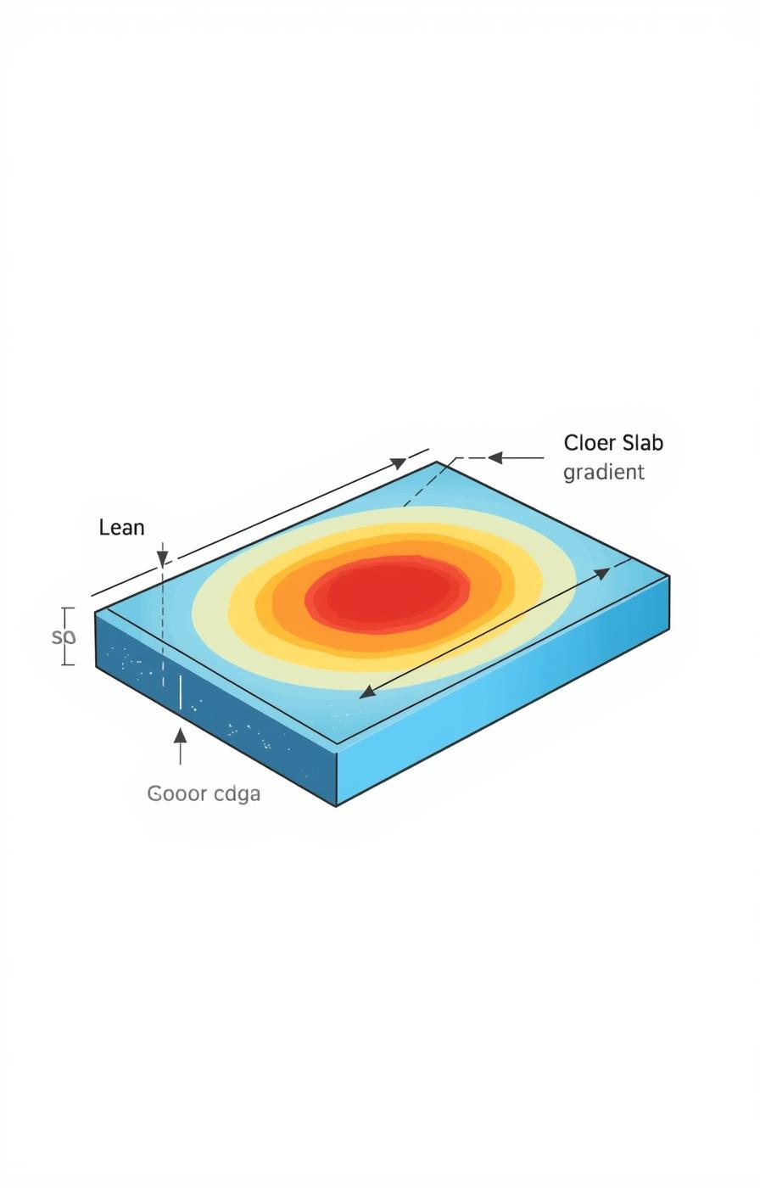

Heat Conduction in a Finite Slab
SAMIA BABAR | HUZAIFA MANSOOR | AMNA TAHIR | ESHMAL RAZA | NOOR FATIMA

Slide 2

Understanding Temperature Changes in a Slab
This model examines how temperature evolves over time within a slab when exposed to cooling at its ends, illustrating the fundamental principles of heat conduction in solid materials.

Slide 3
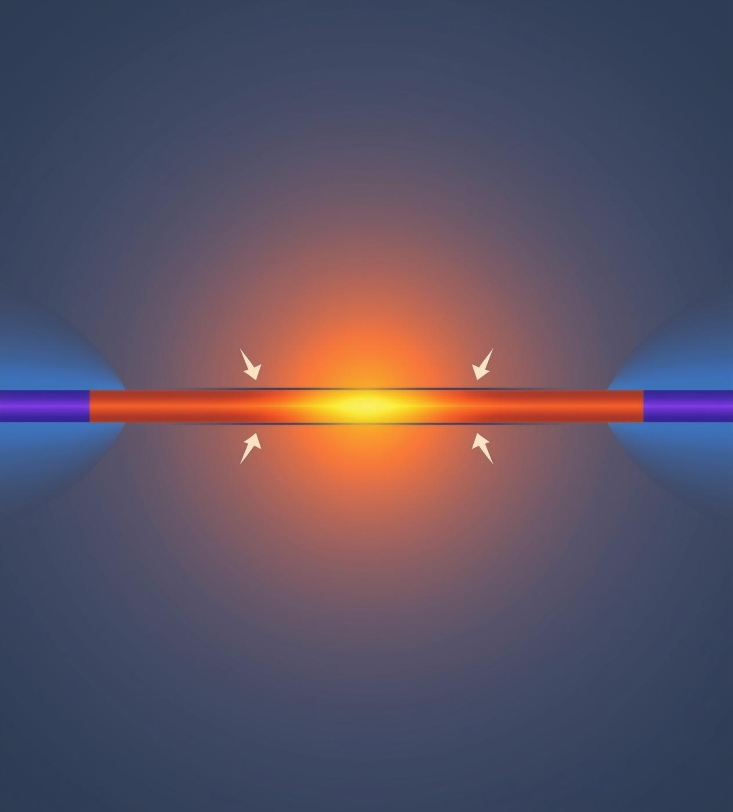
Real-life Analogy: Metal Rod Cooling
Consider a hot metal rod cooled at both ends. Heat flows from the warm center to the cooler edges, illustrating how temperature gradients drive energy transfer through conduction in materials.

Slide 4
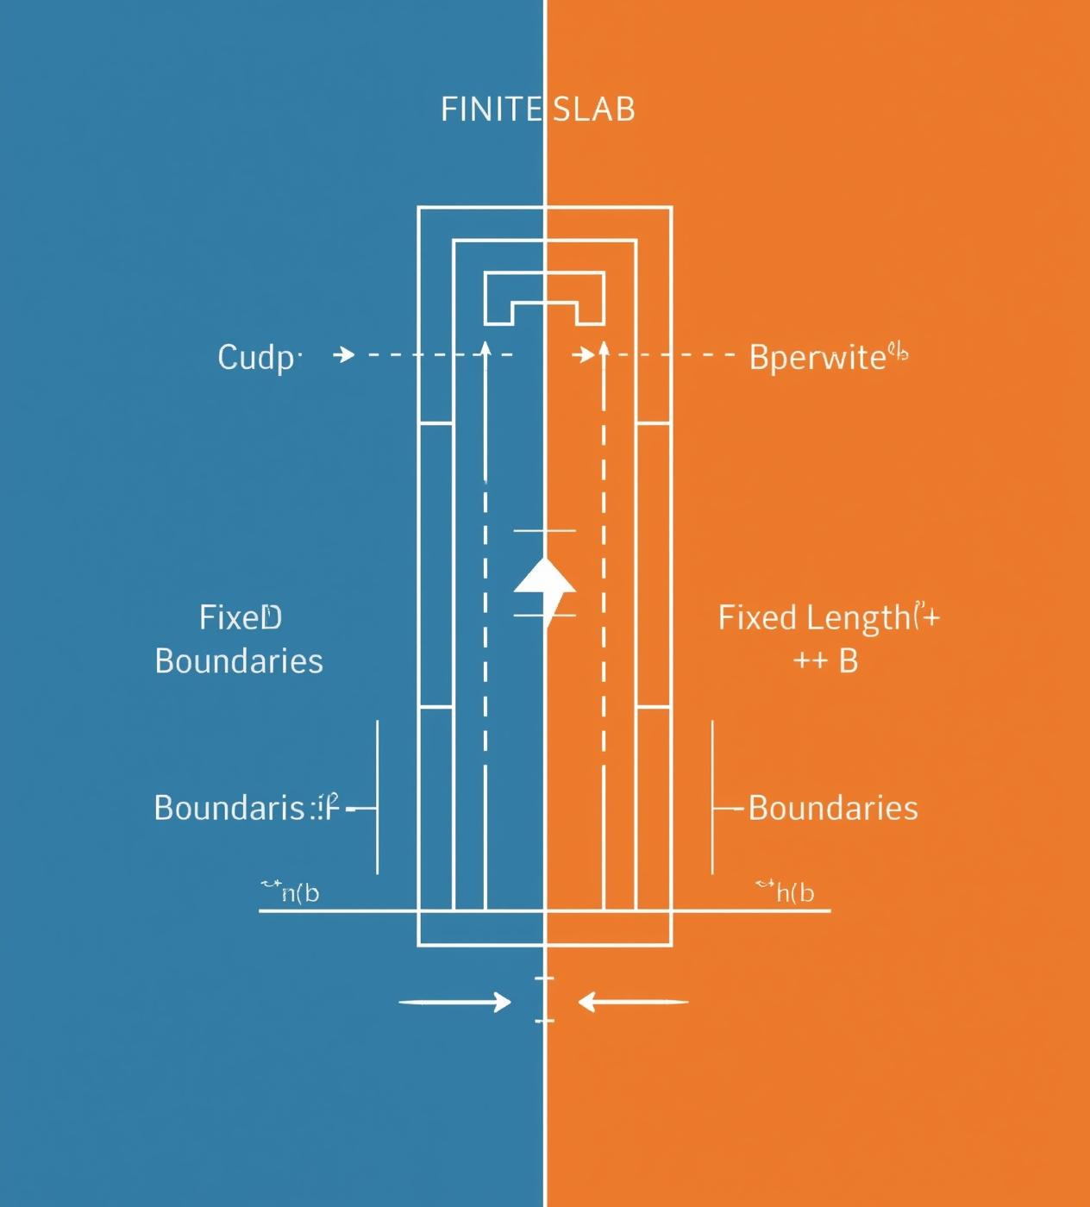
Understanding the Finite Slab Model
The finite slab model has fixed length and two physical boundaries, ensuring that heat cannot escape from the ends, which simplifies analysis and focuses on conduction within defined limits.

Slide 5
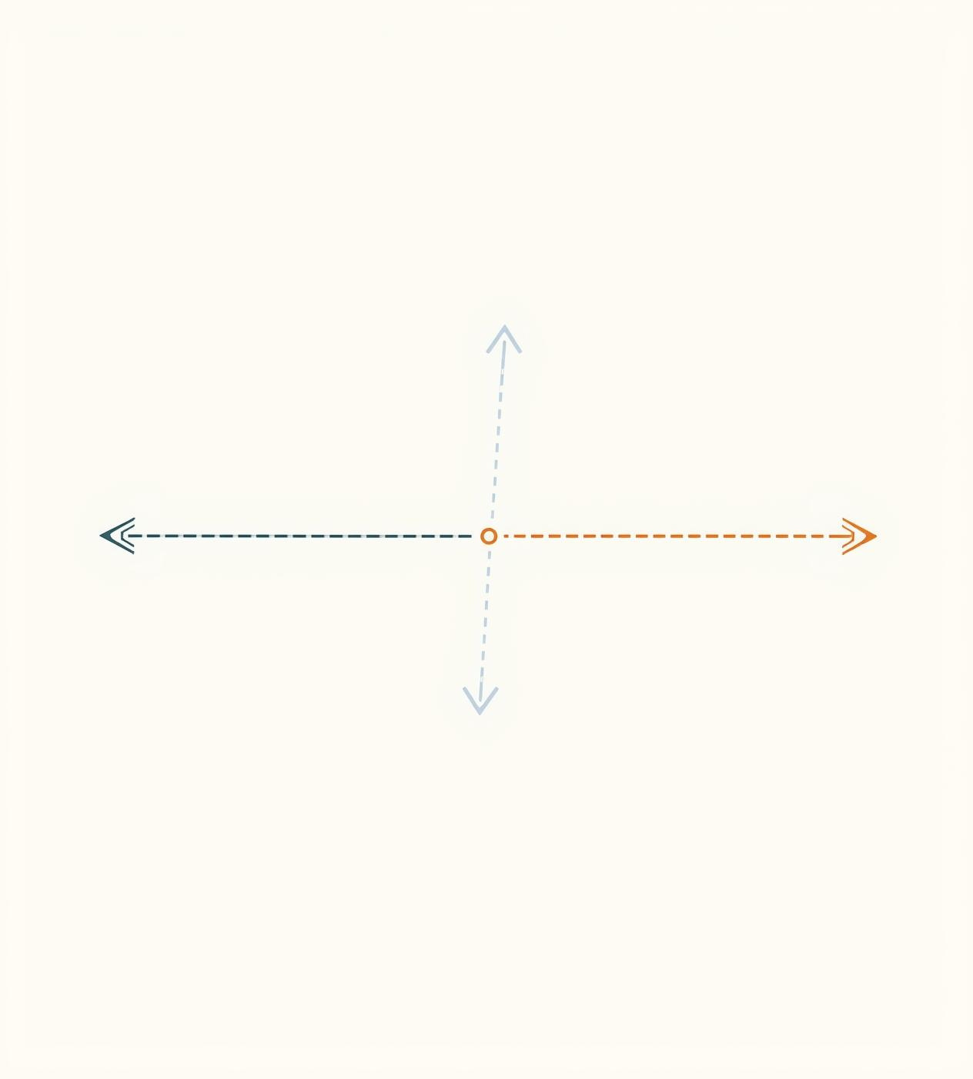
Why Use a 1D Model?
The 1D model simplifies analysis, focusing on heat flow primarily from left to right. This assumption allows for easier calculations while maintaining accuracy for scenarios where temperature variations across width and height are negligible.

Slide 6
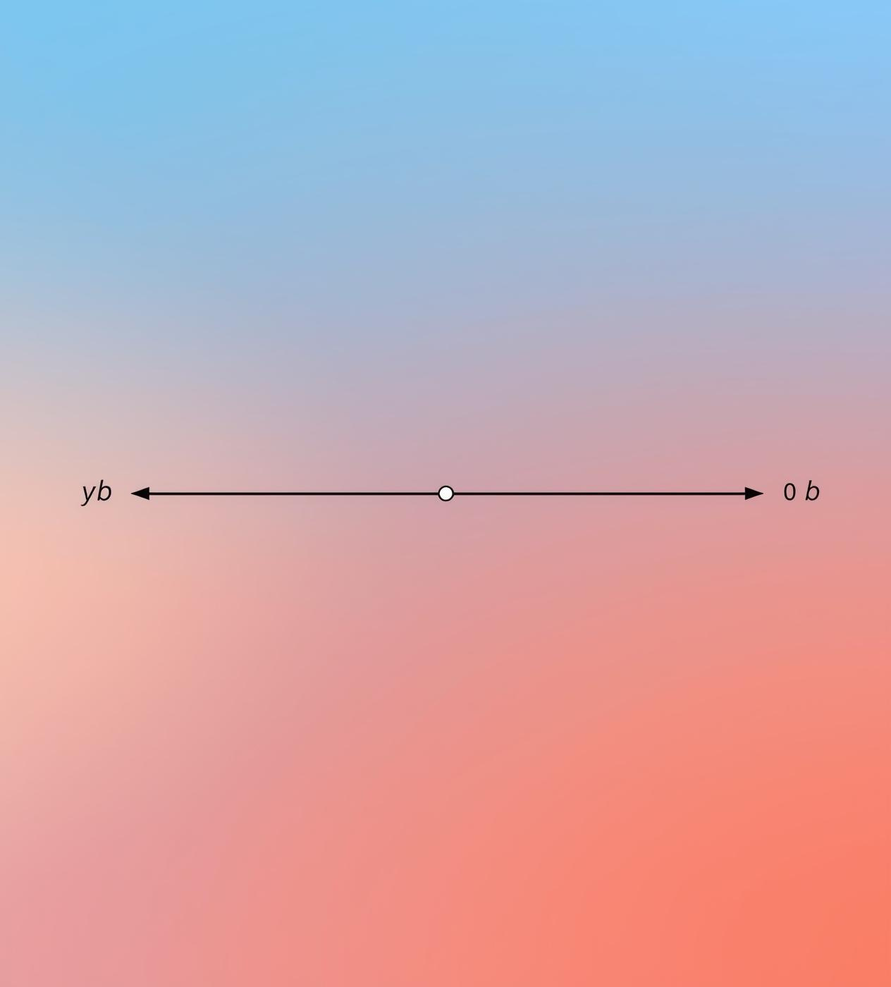
Domain Definition of the Slab
The finite slab is defined with boundaries at left end −b, center 0, and right end +b. This setup allows for clear analysis of temperature gradients across the slab's length during heat conduction.

Slide 7
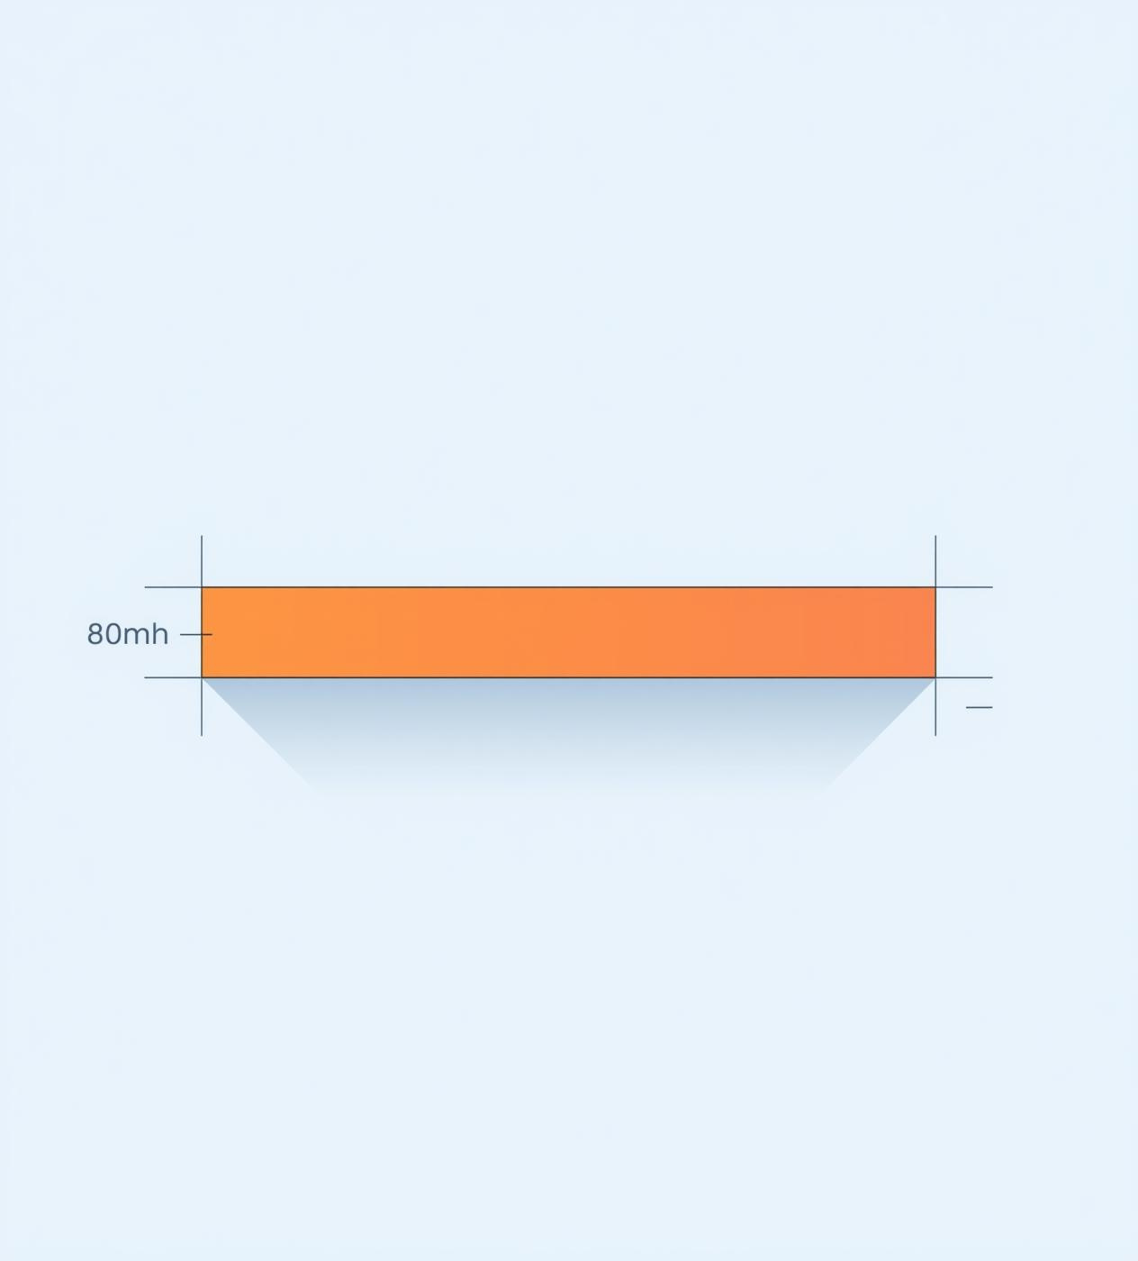
Initial Temperature Condition
At time ( t=0 ), the slab maintains a uniform temperature throughout its entire length, indicating no temperature gradients. This state is essential for initiating the heat conduction process effectively.

Slide 8
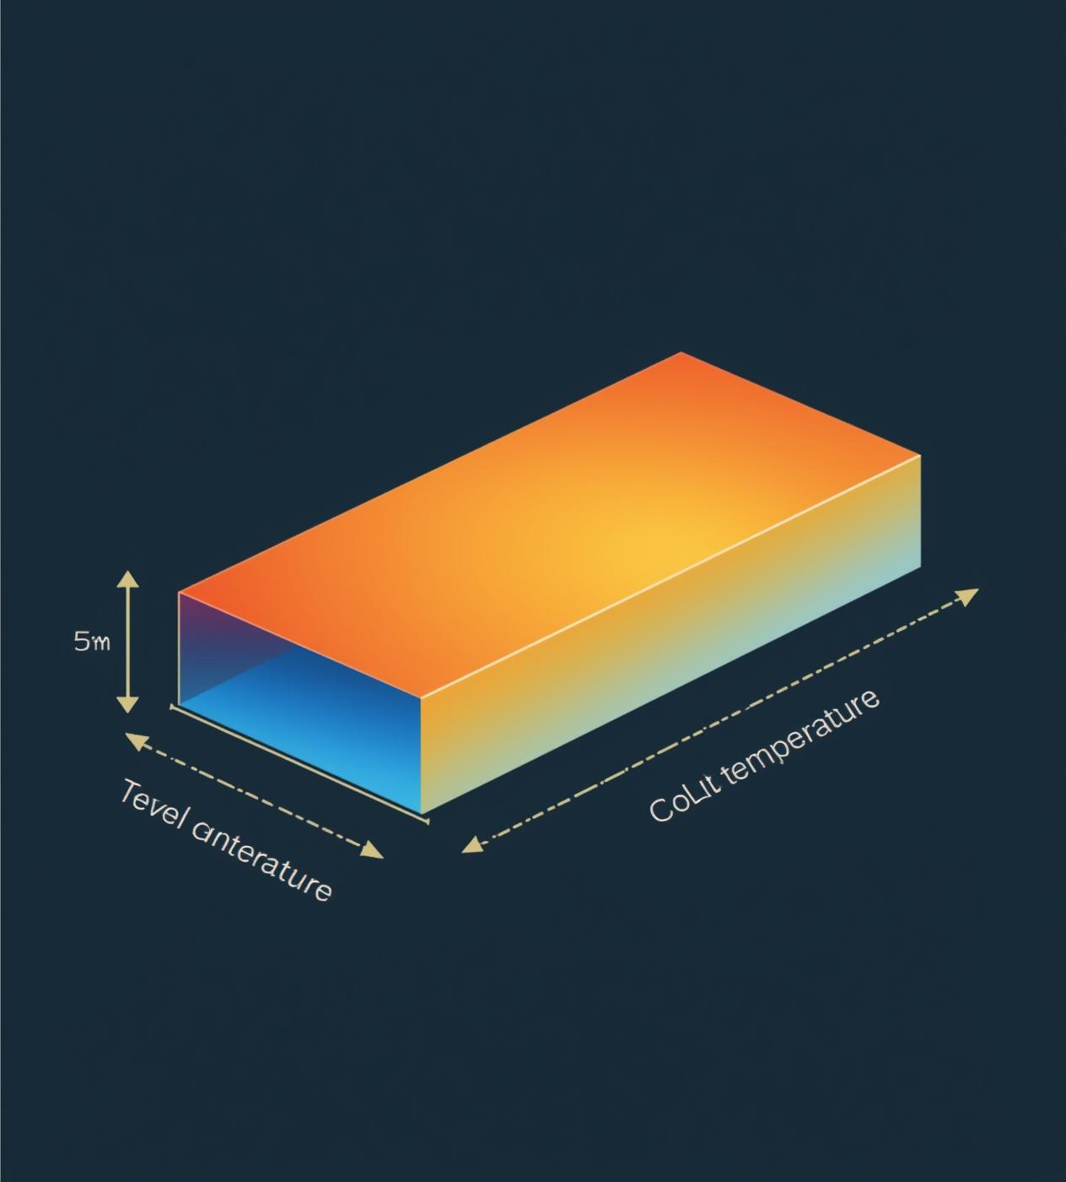
Boundary Condition at t=0
At time t=0, the slab's ends are suddenly cooled, creating a distinct temperature gradient. The center remains hot while the ends transition to a lower temperature, initiating heat conduction.

Slide 9
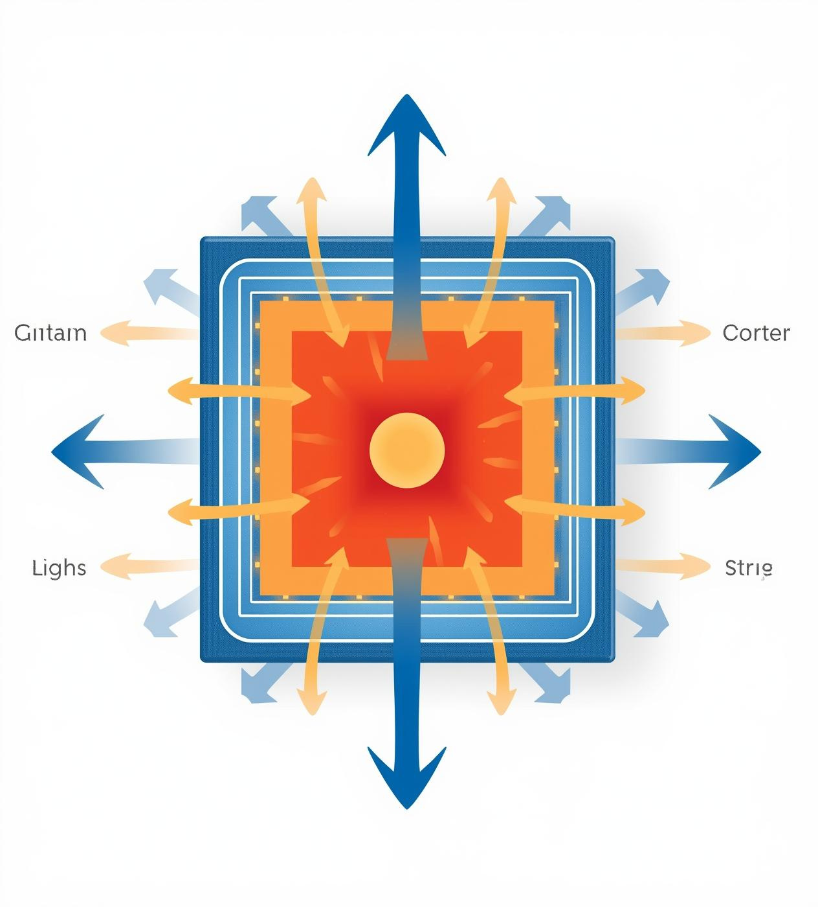
Understanding Heat Flow Dynamics
Heat naturally moves from hot regions to cold ones, driven by temperature gradients. This process creates a flow of energy, leading to temperature changes over time within the material.

Slide 10

Governing the Heat Equation
The heat equation drives temperature changes, illustrating how heat diffusion smooths gradients over time. This model highlights the gradual transition from hot to cold regions within the slab.

Slide 11
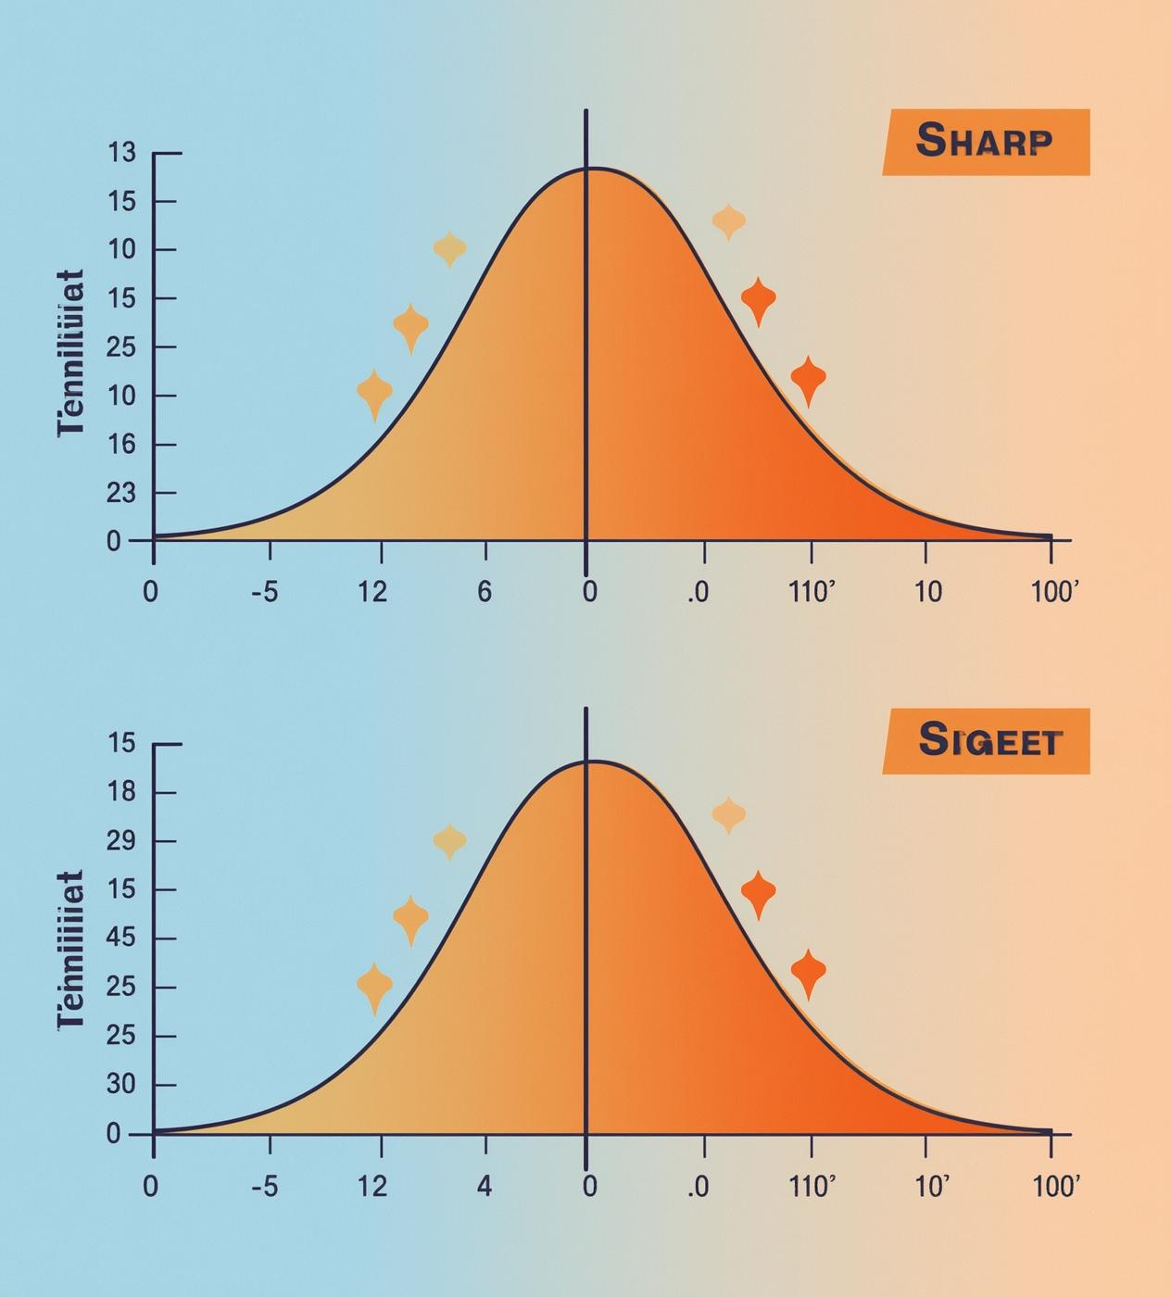
Smooth Temperature Transition Concept
To ensure stability in simulations, we utilize a smooth step function. This approach avoids sudden temperature jumps, resulting in realistic transitions that reflect physical phenomena and improve computational accuracy.

Slide 12
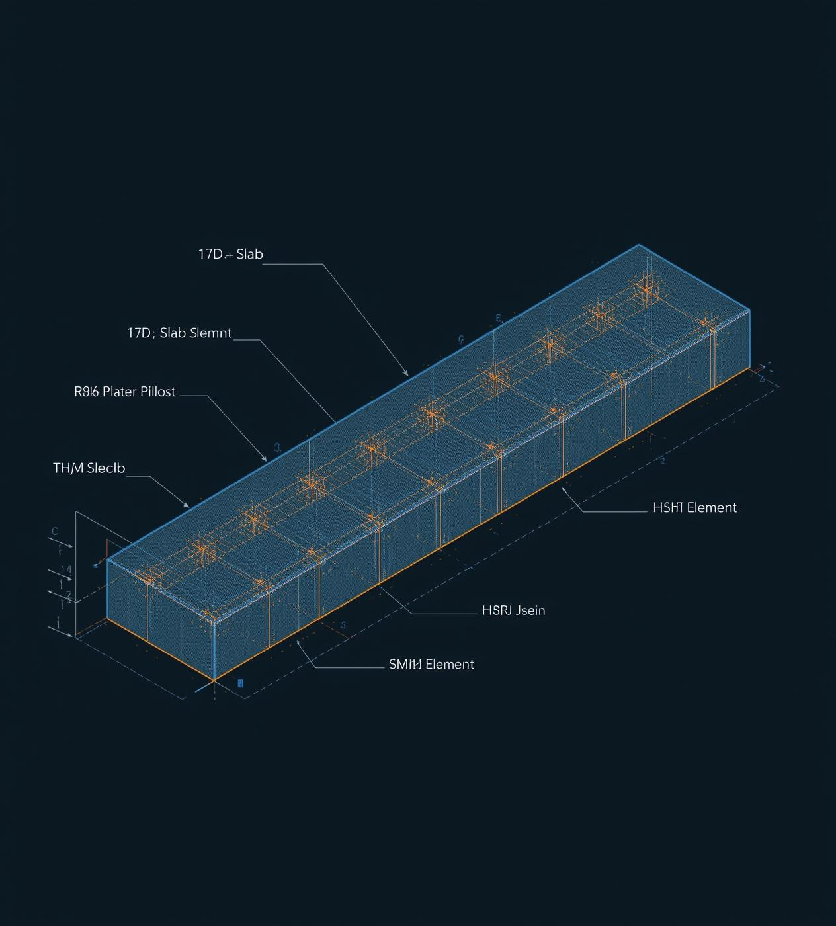
COMSOL Mesh Element Division
The COMSOL model divides the slab into small elements to accurately simulate heat conduction. Each element uses the heat conduction law, ensuring precise tracking of temperature changes over time.

Slide 13
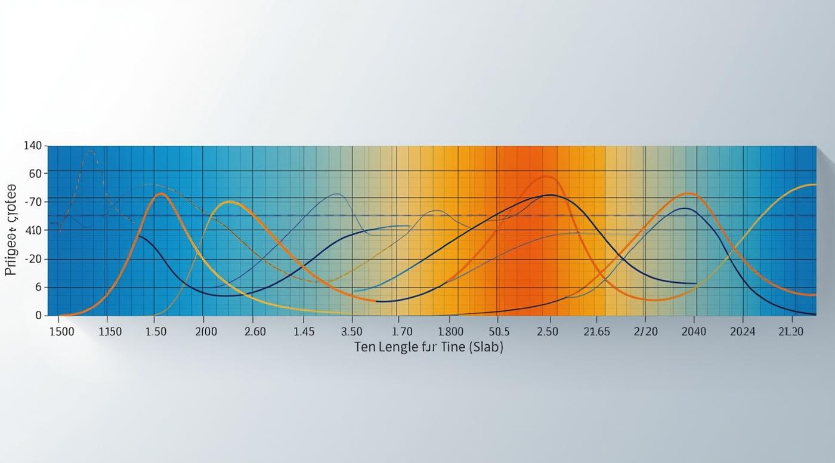
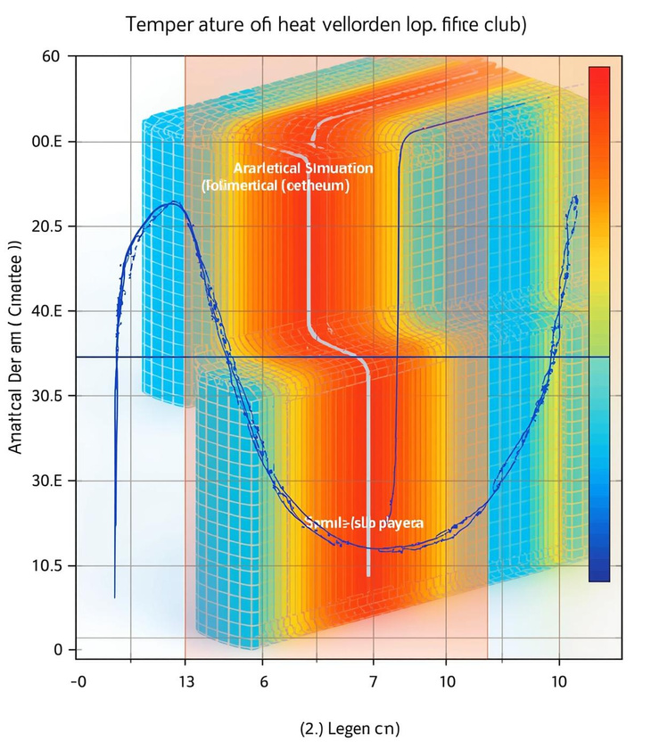
Temperature Profiles Over Time

Slide 14
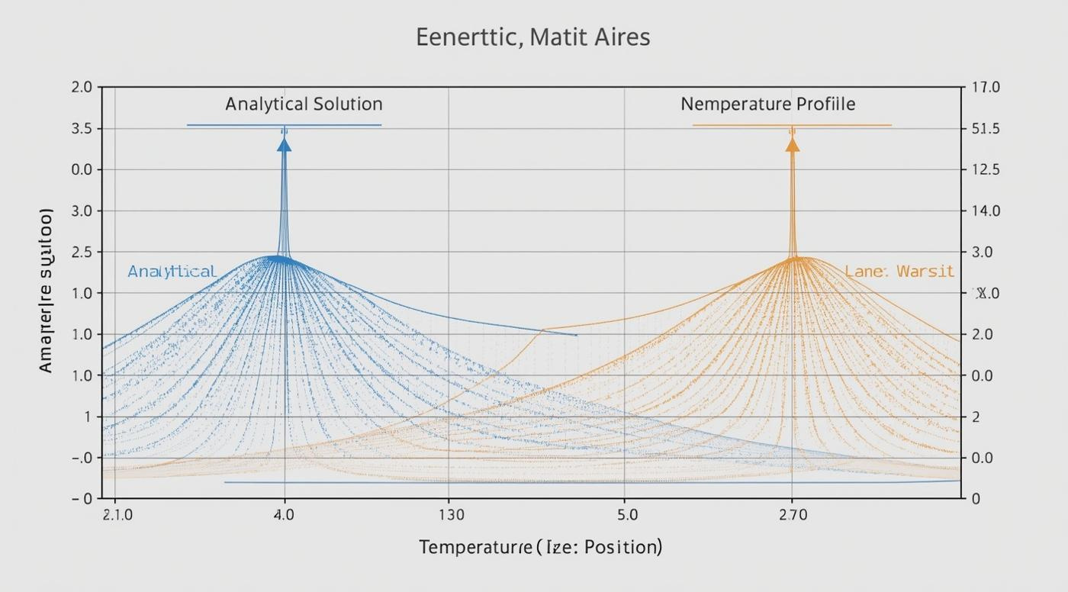
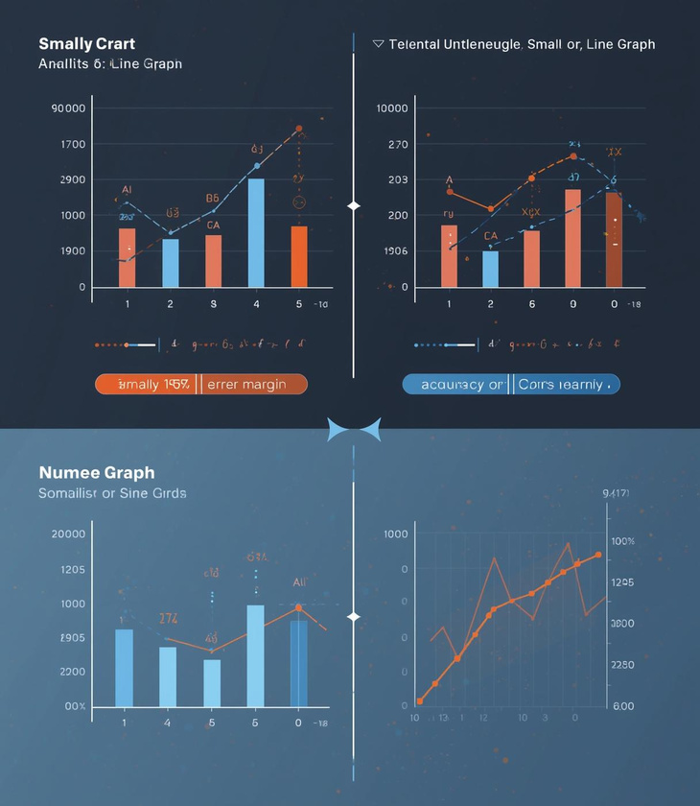
Validation of COMSOL Model Results

Slide 15
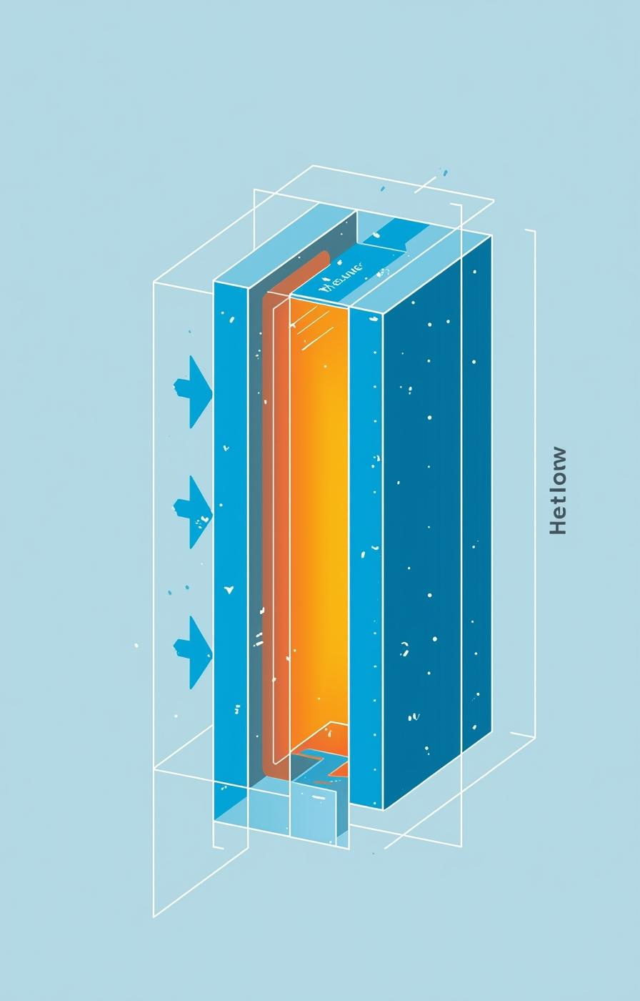

MODEL SUMMARY
This entire model is about one simple physical idea:
When the ends of a hot solid are cooled, heat flows from the interior toward the ends, and the temperature inside the solid changes gradually with time.
Everything else in the model exists only to describe, calculate, and visualize this behavior.

Slide 16
HAVE ANY QUESTIONS?
FEEL FREE TO ASK

